Slide 1
Microservices and DevOps
DevOps and Container Technology
Microservice Tests
Henrik Bærbak Christensen

Slide 2
Sources
Note on the ‘infodeck’ [Clemson, 2014]
https://martinfowler.com/articles/microservice-testing/
Use arrows for navigation, not page down as you miss stuff!

Slide 3
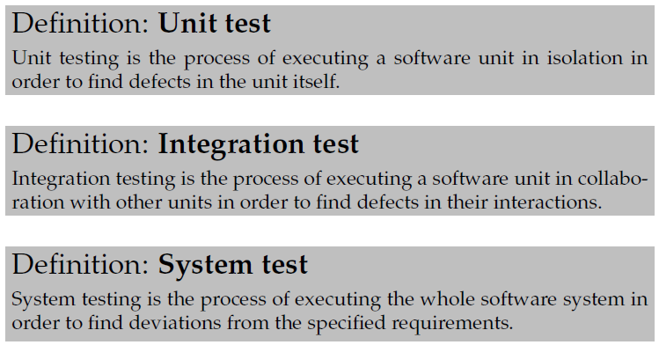
The Classic Take on Testing
Old-time ‘programs’ had three levels of testing:
The Algorithms
The Collaboration
The User Expectation

Slide 4
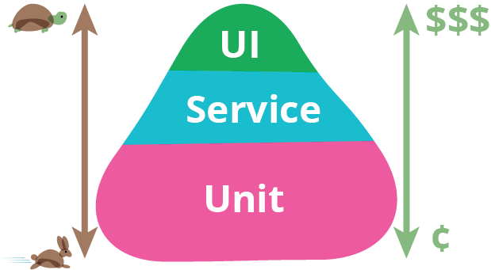
Test Pyramid
Unit tests
Tests individual methods, classes
Service tests
Tests service with doubled collaborators
End-to-End tests
Functionality, user expectations
Notes:
https://martinfowler.com/bliki/TestPyramid.html

Slide 5
Unit Tests
In detail the picture becomes a bit blurred…

Slide 6
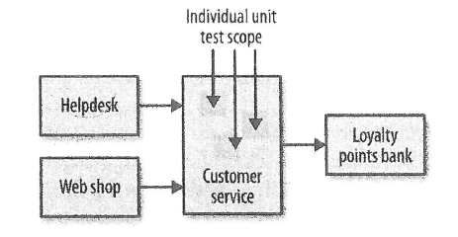
Unit Tests
Testing the “algorithms”, the computation
Methods, the classes as a unit…
Fast!
We all know what unit tests are, right?
I would say ‘no’…

Slide 7
TDD and Unit Test
Test-Driven Development
Clean (production) code that works as a result of a systematic process driven by tests…
Dogmatic: ”No production code is ever written expect when forced to do so because otherwise a test will fail!”
Central principle: Fake it till you make it
Need-driven development
Outside-in development
Design API before implementing it
Notes:
https://martinfowler.com/articles/mocksArentStubs.html

Slide 8
Example:
When I started the SkyCave development I had this architecture in mind:
Very first test case in my TDD: query player’s room
Lead to ‘playerServant’ updating from storage:
Player Servant
PlayerProxy
<<i>>
CaveStorage

Slide 9
Example:
As there was no CaveStorage, I faked-it, introducing a double
Player Servant
FakeCS
PlayerProxy
<<i>>
CaveStorage

Slide 10
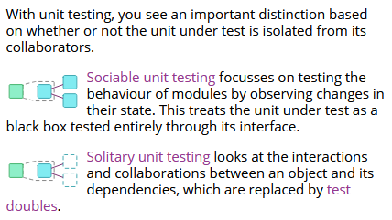
Example:
So – what happened? What did I do???
Unit testing of ‘player.getShortDescription()’ algorithm?
Integration testing the player – storage collaboration?
Bottom line
Both ☺
… thus blurring the borderline!
Notes:
https://martinfowler.com/articles/microservice-testing/#testing-unit-introduction

Slide 11
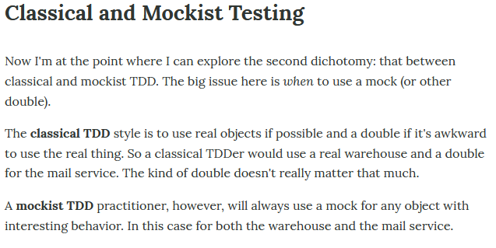
Fowler
I am a classical TDD’er. I just use doubles a lot.
A Mockist would code the CaveStorage mock to ensure a single ‘getPlayerByID()’ call was made. Tend to make tests very white-box and thus more fragile - IMO!
Notes:
https://martinfowler.com/articles/mocksArentStubs.html

Slide 12
Service Tests
In detail the picture becomes a bit blurred again ☺…

Slide 13
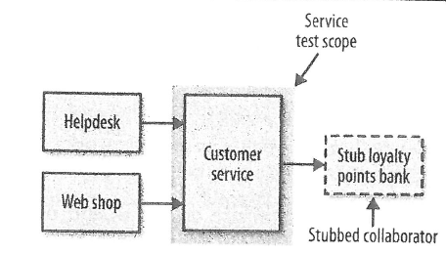
Service Tests
Akin to system tests at the service level
Bypasses the user interface and test services directly
Tests an individual service’s capabilities
Need to stub out all external collaborators so only the service itself is in scope
Critique: Newman is imprecise in what ‘stubbing’ is
“If you decide to … go over network to stubbed downstream collaborators”

Slide 14
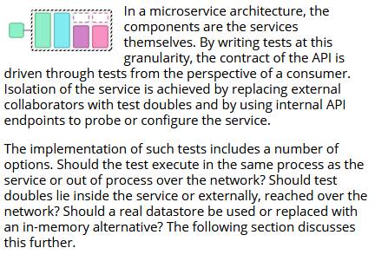
Fowler: Component Test
Fowler instead calls them component tests
limits the scope to a portion of the system under test (the microservice itself), manipulating through internal code interfaces, using test doubles to isolate.
And explicitly talks about
In-process and out-of-process approach for doubles
Notes:
https://martinfowler.com/articles/microservice-testing/#testing-component-introduction

Slide 15
Service Test Example
Service test ‘daemon’ service’s quote retrieval feature
In-process approach: inject ‘StubQuoteService’ into PlayerServ.
Out-of-process approach: inject ‘RealQuoteService’ but make it call a (Mountebank) test double service
StubQS
Player Servant
<<i>>
QuoteService
Player Servant
<<i>>
QuoteService
QuoteServer
Quote Service Double
RealQS

Slide 16
Exercise:
What are the benefits and liabilities of each approach?
In-process approach: inject ‘StubQuoteService’ into PlayerServ.
Out-of-process approach: inject ‘RealQuoteService’ but make it call a Mountebank test double service
StubQS
Player Servant
<<i>>
QuoteService
QuoteServer
Player Servant
<<i>>
QuoteService
Quote Service Double
RealQS
Notes:
In-process: Much easier test harness, fast, but does not test the RealQS code. Out-of-process: Tricky harness, slow tests (have to start services), but does test RealQS.

Slide 17
Exercise:
And the really tricky question:
Is the test above a…
Unit test of ‘getQuote()’?
Service test of PlayerServant?

Slide 18
End-to-End Tests
Perhaps not that blurred…

Slide 19
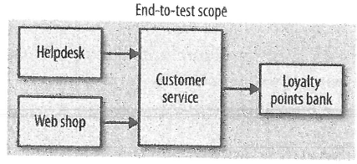
End-to-End Tests
User value focus: functionality
As much as possible of system is under test
Real database, etc.

Slide 20
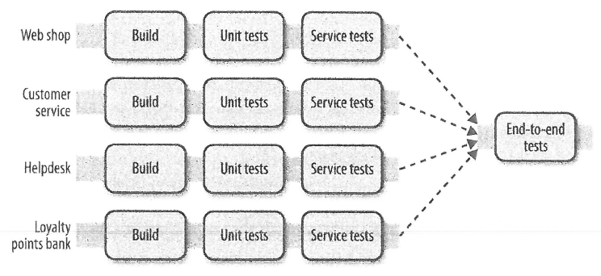
In the Pipeline
Trigger End-to-End tests on every service release
Ideally…

Slide 21
Flaky, Brittle Tests
Flaky Test: Tests that fail randomly due to non-determinism in the environment (timing, race conditions, threading, …)
Normalization of deviance: We get so used to failing tests occasionally that we start thinking that this is the norm!
I.e. we get blind when failing is due to a real issue that needs fixing; and thus the issue persists!
Similar:
Getting used to 236 compiler warnings => you miss important ones!

Slide 22
Test Ownerships
Who owns the end-to-end tests?
Newman mentions several anti-patterns
Free for all ☹.
Number explodes => End-to-End tests takes too long
Dedicated team ☹.
Gets isolated from development teams, becomes bottleneck
Best balance
Shared codebase, joint ownership

Slide 23
Long Running Tests
Slow running tests that are flaky are poison!
Slow to run, slow to diagnose, painful and slow to remedy
Pile-up: Lots of work (commits) pile up while failed E2E tests are diagnosed, corrected, rerun…
Tests are difficult to remove due to human nature
Who gets rewarded for removing a test?
Especially, if that missing test would have caught a defect???

Slide 24
Journeys, Not Stories
Recommendation:
Have a small test of test cases that tests journeys; not test cases for every user story/use case
Very low level double digits for even complex systems
5-20 journey tests?
Ordering a product, create customer, returning a product – and not much else!

Slide 25
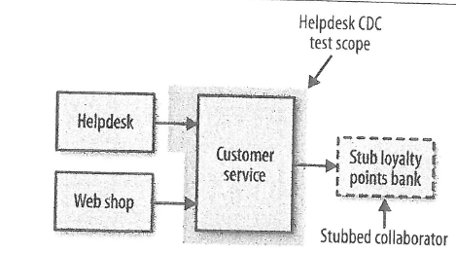
Consumer-Driven Tests
CDT: Create tests that capture expectations of the consumer of the service
Thus ‘helpdesk’ service runs CDT’s on the Customer service
Similar ‘web shop’ runs their own CDT’s against the CS
Note: Test double for the loyalty point service
CDT ownership?
“It’s about conversations” – provide a ‘contract’ between services and thus teams. So – collaboration…

Slide 26
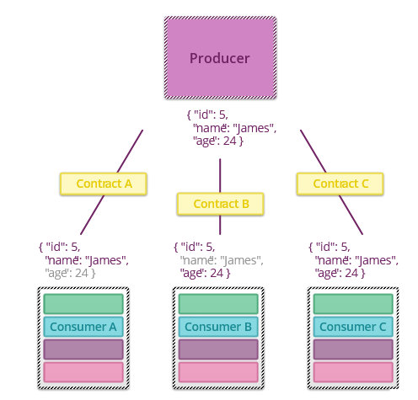
Fowler: Contract Tests
Fowler identifies the exact same need.

Slide 27
What is the API Then?
Which API does CDTs communicate by?
The protocol level (typically REST)
Which of course is a out-of-process test
Slow and tedious, not part of the ‘gradle test’ cycle
QuoteServer
Player Servant
<<i>>
QuoteService
Quote Service Double
RealQS

Slide 28
Fowler Integration Tests
Missing in Newman…
Bærbak: Connector Tests

Slide 29
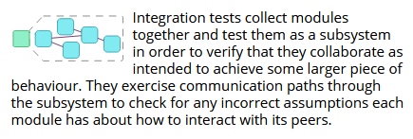
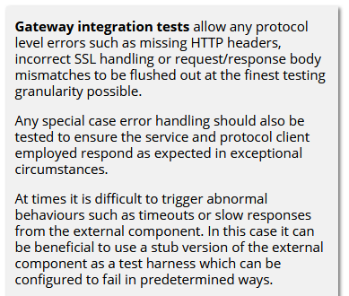
Integration Testing
Focus is more on design for failure…

Slide 30
Integration Test
IMO the integration tests embody testing the connector/driver that the consumer uses to interact with the service
And the connectors dealing with failure modes
Which of course is a out-of-process test
Slow and tedious, not part of the ‘gradle test’ cycle
QuoteServer
Player Servant
<<i>>
QuoteService
Quote Service Double
RealQS

Slide 31
Connector Test
In the Software Architecture lingo, the dynamic view of an executing system is called the component connector view
Component: Executing process ‘doing stuff’
Connector: The flow of control/data between components
Fowlers integration tests are thus (in my mind) a test of the connector. Here the RealQuoteService impl.
Connector Test is a better term IMO
QuoteServer
Player Servant
<<i>>
QuoteService
Quote Service Double
RealQS

Slide 32
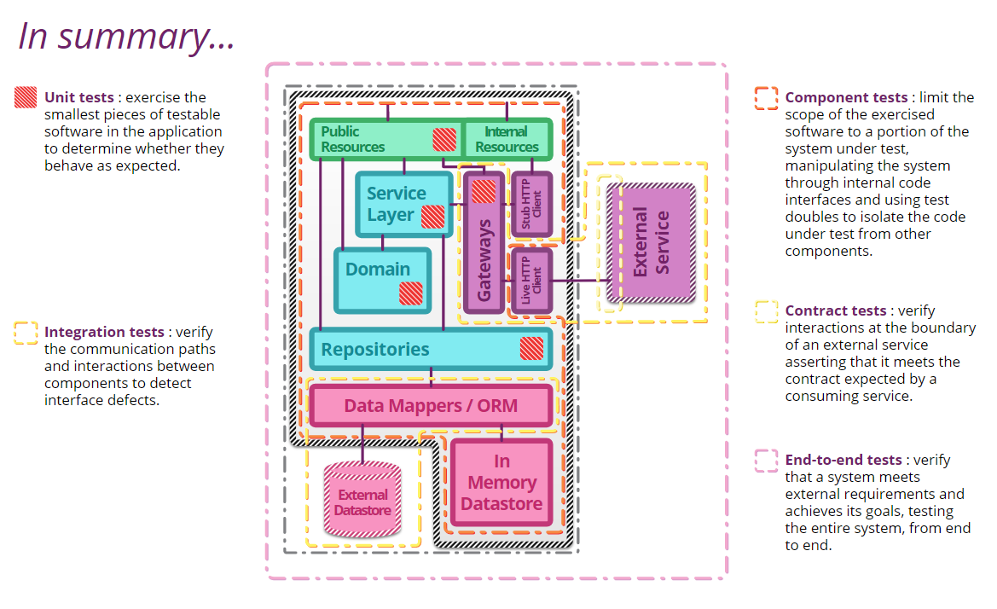
Summary
Service tests
No Newman Equivalent
Consumer Driven Tests
Test Journeys
Bærbak: Connector Test

Slide 33
In Practice
Relation to SkyCave

Slide 34
Rich Picture Architecture
Daemon
Player Servant
FakeCS
PlayerProxy
<<i>>
CaveStorage
MongoDB
RealCS
StubQS
<<i>>
QuoteService
QuoteServer
RealQS
…
= Local call
= Network call

Slide 35
Service Test (in-process)
Daemon
Player Servant
FakeCS
PlayerProxy
<<i>>
CaveStorage
MongoDB
RealCS
StubQS
<<i>>
QuoteService
QuoteServer
RealQS
…
= Local call
= Network call

Slide 36
Service Test (out-of-process)
Daemon
Player Servant
FakeCS
PlayerProxy
<<i>>
CaveStorage
MongoDB
RealCS
StubQS
<<i>>
QuoteService
QuoteServer
Quote Service Double
RealQS
…
= Local call
= Network call
Notes:
Fongo er en ‘fake mongo’ som er in-memory som man kunne teste med.

Slide 37
Integration/Connector Test
Daemon
Player Servant
FakeCS
PlayerProxy
<<i>>
CaveStorage
MongoDB
RealCS
StubQS
<<i>>
QuoteService
QuoteServer
RealQS
…
= Local call
= Network call

Slide 38
Contract Test / ConsumerDriven T.
Daemon
Player Servant
FakeCS
PlayerProxy
<<i>>
CaveStorage
MongoDB
RealCS
StubQS
<<i>>
QuoteService
QuoteServer
RealQS
…
= Local call
= Network call

Slide 39
Test Journeys
Daemon
Player Servant
FakeCS
PlayerProxy
<<i>>
CaveStorage
MongoDB
RealCS
StubQS
<<i>>
QuoteService
QuoteServer
RealQS
…
= Local call
= Network call

Slide 40
Gradle and SkyCave
Handling Out-of-process Tests

Slide 41
Precursor to ContInt
The ‘tip of the test pyramid’ tests are slow and ‘expensive’ to run
Conclusion:
Not part of normal development rhythm
TDD Step 4: Run all tests and see them pass…
Should be in the seconds timeframe
Gradle ‘test’ target
Runs all JUnit tests ☹

Slide 42
The Solution
In SkyCave I like to keep your solution code in a single Gradle project
Not really the microservice doctrine, but makes it possible for me to review your code!
Subproject ‘integration’
Task ‘itest’
Put your ‘out-of-process’ tests here…

Slide 43
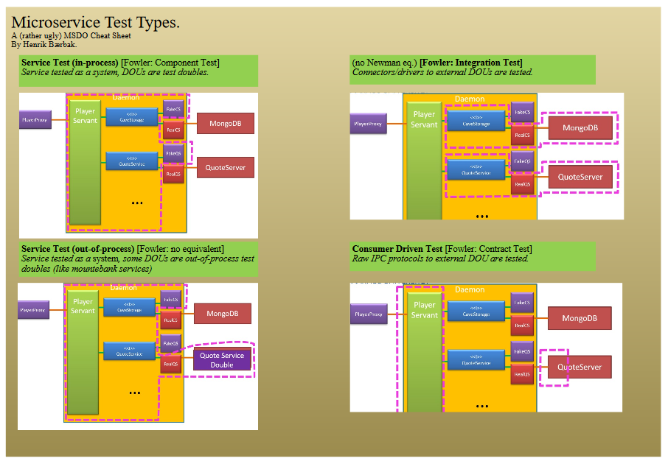
Lots of Terms
Find the ‘test type’ cheat sheet on Weekplan 4
(Yes, I am not a graphical designer ☺)

Slide 44
Summary
Microservice architecture introduces a lot of new test types
Because integration tests have a decision to make
In-process integration – replace service with a local double
out-of-process integration – replace service with remote double
When out-of-process you also have two choices
CDT/Contract test
E.g. Call using raw connector, like POST, GET etc.
Integration test
E.g. Call using using ‘driver’ class, like ‘RealQuoteService’
And you often need both
CDT to facilitate suppliers development
IntTest to test your own driver code base

